Slide 1

Seasonal Agriculture Performance Analysis
Devpal Singh Charanjeet Singh Anand,
Amity University Online, Noida
AICTE STU ID : STU658299becb6581703057854

Slide 2

PROBLEM STATEMENT
Agricultural activities depend on different seasonal conditions, farming practices, availability of resources, and market conditions. Because these factors change from season to season, agricultural performance can also vary.
The problem is that raw agricultural data does not directly show how performance changes across different seasons or what patterns exist under different seasonal conditions. Therefore, the objective is to analyze the given agricultural dataset and understand these seasonal differences by identifying meaningful patterns, trends, relationships, and variations in the available data.

Slide 3
Project Description
Dataset: 4,000 farm records spanning the Kharif, Rabi and Zaid seasons, with 28 attributes covering geography, environmental conditions, input usage and farm economics.
Tools: Python with Pandas and NumPy for data handling, SciPy for statistical testing, and Matplotlib/Seaborn for visualization, run in Jupyter Notebook.
Cleaning: Missing values in Rainfall, Soil Moisture and Yield (about 1% each) filled using season-wise medians; categorical columns standardized; Profit_Margin_pct and Is_Loss features derived.
Exploratory Analysis: Univariate, bivariate and multivariate analysis of yield, profit, climate and risk variables across the three seasons.
Statistical Testing: Kruskal-Wallis test for yield (skewed distribution) and one-way ANOVA for profit, water efficiency and disease/pest risk, confirming seasonal differences are statistically significant (p < 0.001).
Insight Extraction: Correlation heatmaps and grouped comparisons used to identify the strongest seasonal drivers of agricultural performance.

Slide 4

WHO ARE THE END USERS?
Farmers & Agri-Cooperatives: Plan sowing, irrigation and input use around season-specific yield and risk patterns.
Agricultural Policy Makers: Use seasonal profit and loss trends to design subsidy, insurance and support schemes.
Crop Insurance Providers: Assess seasonal risk (loss share, disease/pest risk) to price policies more accurately.
Agri-Input Suppliers: Time fertilizer, pesticide and irrigation product marketing to season-specific demand.
Agricultural Researchers & Analysts: Use the findings as a baseline for further seasonal and regional studies.

Slide 5

Technology Used
Python: Core programming language used for the analysis.
Pandas: Used for data loading, cleaning, transformation, and grouping.
NumPy: Used for numerical operations and calculations.
Matplotlib: Base plotting library used for charts (histograms, scatter plots, bar charts).
Seaborn: Used for statistical visualizations including the correlation heatmap.
Google Colab / Jupyter Notebook: Cloud-based notebook environment used to run the full analysis.

Slide 6
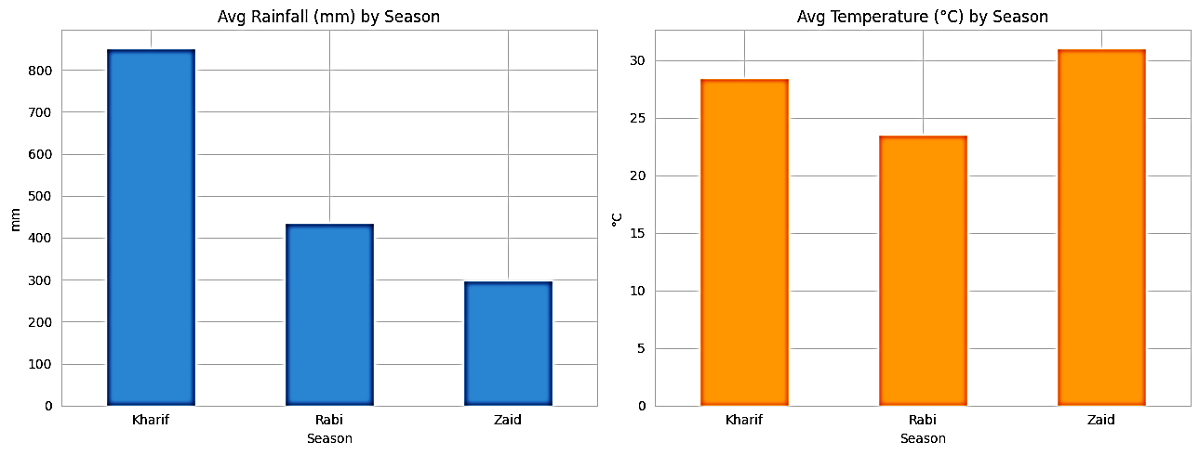
RESULTS
Key Observations:
Rainfall: Kharif receives the highest average rainfall at approximately 852 mm, while Zaid receives the least at around 299 mm.
Temperature: Zaid is the hottest season, with an average temperature of approximately 31.0°C, despite receiving the least rainfall.
Overall: Kharif is characterized by high rainfall, while Zaid experiences hotter and drier conditions.

Slide 7
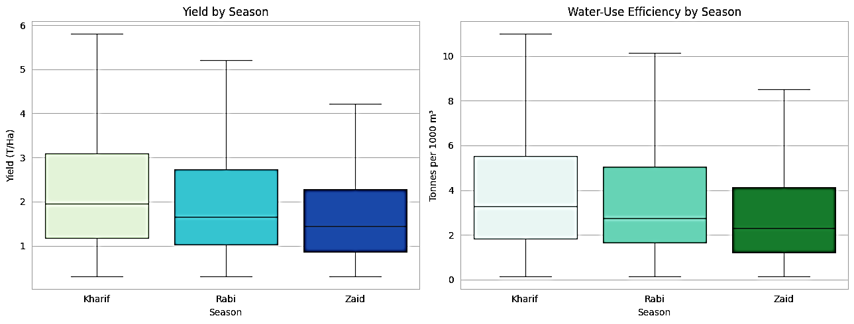
RESULTS
Key Observations:
Yield: Kharif has the highest median yield at 1.95 T/Ha, followed by Rabi at 1.66 T/Ha and Zaid at 1.45 T/Ha.
Water-Use Efficiency: Water-use efficiency follows the same order as yield, with Kharif performing best and Zaid lowest.
Overall: Kharif shows the highest yield and water-use efficiency, while Zaid records the lowest values. Statistical tests indicate significant differences across seasons (p < 0.001).

Slide 8
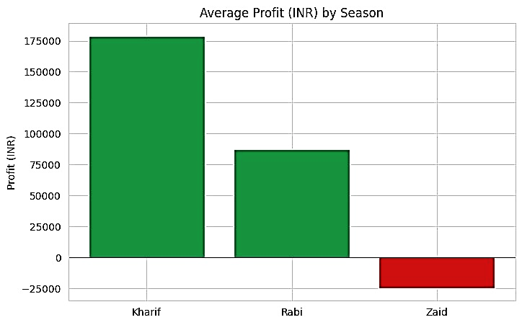
RESULTS
Key Observation:
Profitability: Average profit declines sharply across seasons, from ₹1,78,915 in Kharif to ₹87,689 in Rabi, while Zaid records a net loss of ₹24,805. Zaid is the only season with negative average profitability, with the differences across seasons being statistically significant (p < 0.001).

Slide 9
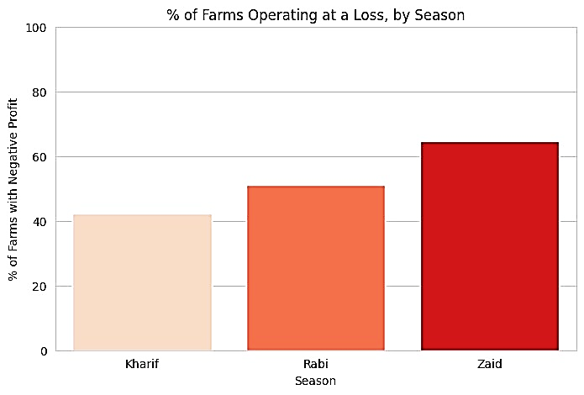
RESULTS
Key Observation:
Loss-Making Farms: The share of loss-making farms increases from 42.2% in Kharif to 51.1% in Rabi and 64.5% in Zaid. By Zaid, the majority of farms are operating at a loss.

Slide 10
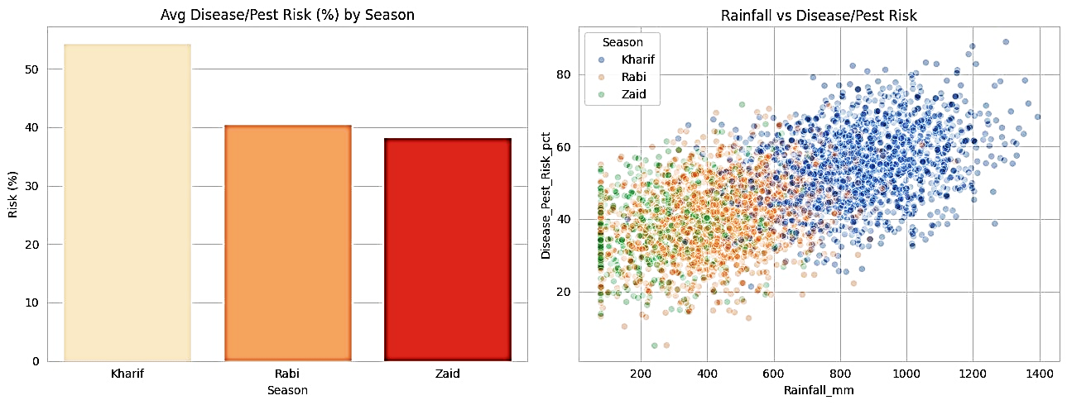
RESULTS
Key Observations:
Disease/Pest Risk: Disease/pest risk is higher in Kharif (54.5%) than in Zaid (38.2%).
Rainfall Correlation: Disease/pest risk shows a strong positive correlation with rainfall (r ≈ 0.63), indicating that higher rainfall is associated with greater crop-health risk.
Overall: Kharif combines higher rainfall with greater disease/pest risk, showing that the season with stronger crop performance also faces greater crop-health challenges.

Slide 11
Future scope
Predictive Modeling: Build regression/ML models to forecast yield and profit for upcoming seasons using climate and input data.
Loss-Risk Classification: Train a classifier to flag farms at high risk of loss before the season, enabling early intervention.
Real-Time Weather Integration: Combine live rainfall/temperature feeds with the model for dynamic, in-season advisories.
Regional Expansion: Extend the analysis to state and district level to capture local agro-climatic variation.
Interactive Dashboard: Convert the notebook into a dashboard (Power BI / Streamlit) so farmers and planners can explore seasonal trends themselves.

Slide 12
Conclusion
This project analyzed the agricultural dataset using Python, Pandas, NumPy, Matplotlib, and Seaborn to identify meaningful seasonal patterns, trends, relationships, and variations in agricultural performance.
Agricultural performance varies across seasons, with changes in production and other agricultural indicators reflecting the influence of seasonal conditions and farming-related factors. The analysis helped identify which variables show noticeable differences across seasons and how these variations contribute to overall agricultural performance.
The seasonal comparison provides a clearer understanding of agricultural trends that are not immediately visible in the raw dataset. Visualizations and statistical analysis were used to compare seasonal performance and identify recurring patterns, differences, and relationships within the available data.
For Farmers: These insights can help understand seasonal performance patterns and support better planning of agricultural activities based on observed trends.
For Agricultural Planners & Decision-Makers: Seasonal patterns can support resource planning and more informed decisions by highlighting variations in agricultural performance across different seasons.
For Data Analysts: The notebook provides a structured and reproducible approach for exploring agricultural datasets and identifying seasonal trends that can be further analyzed with new or larger datasets.

Slide 13
Google Colab Link
GitHub Link
Devpal's Seasonal_Agriculture_Performance_Analysis.pptx
Devpal's Seasonal_Agriculture_Performance_Analysis.ipynb

Slide 14
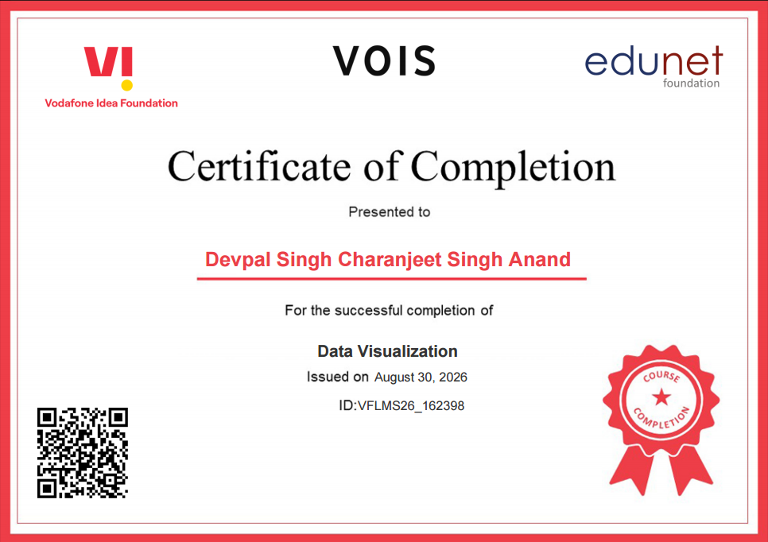
VOIS Course completion certificate -
Course name- Data Visualization

Slide 15
Thank you
.
.

